Slide 1
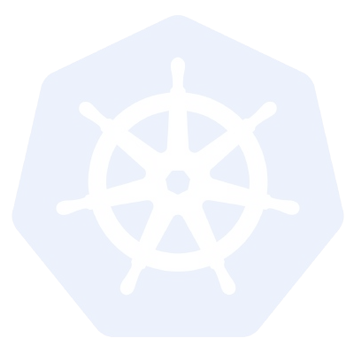
Kubernetes
A Comprehensive Overview
Kubernetes v1.8

Slide 2
Agenda
Introduction
Who am I?
What is Kubernetes?
What does Kubernetes do?
Architecture
Master Components
Node Components
Additional Services
Networking
Concepts
Core
Workloads
Network
Storage
Configuration
Auth and Identity
Behind the Scenes
Deployment from Beginning to End

Slide 3
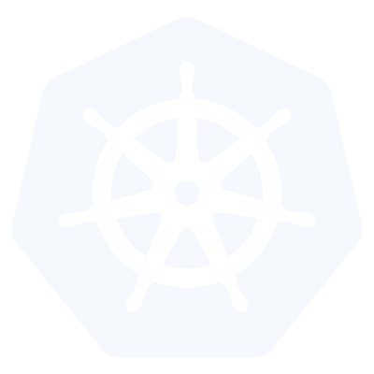
Introduction

Slide 4
Intro - What is Kubernetes?
Kubernetes is a container orchestration technology.
Docker has its own tool called Docker Swarm.
Kubernetes is from Google, and Mesos is from Apache.
Kubernetes or K8s was a project spun out of Google as a open source next-gen container scheduler designed with the lessons learned from developing and managing Borg and Omega.
Kubernetes was designed from the ground-up as a loosely coupled collection of components centered around deploying, maintaining, and scaling applications.

Slide 5
Intro - What Does Kubernetes do?
Kubernetes is the linux kernel of distributed systems.
It abstracts away the underlying hardware of the nodes and provides a uniform interface for applications to be both deployed and consume the shared pool of resources.

Slide 6
Kubernetes
Architecture

Slide 7
Architecture Overview
Kubectl - A client to interact with the cluster and its components.
Masters - Acts as the primary control plane for Kubernetes. Masters are responsible at a minimum for running the API Server, scheduler, and cluster controller. They commonly also manage storing cluster state, cloud-provider specific components and other cluster essential services.
Nodes - Are the ‘workers’ of a Kubernetes cluster. They run a minimal agent that manages the node itself, and are tasked with executing workloads as designated by the master.
Worker Node: Executes the actual work in the cluster.

Slide 8
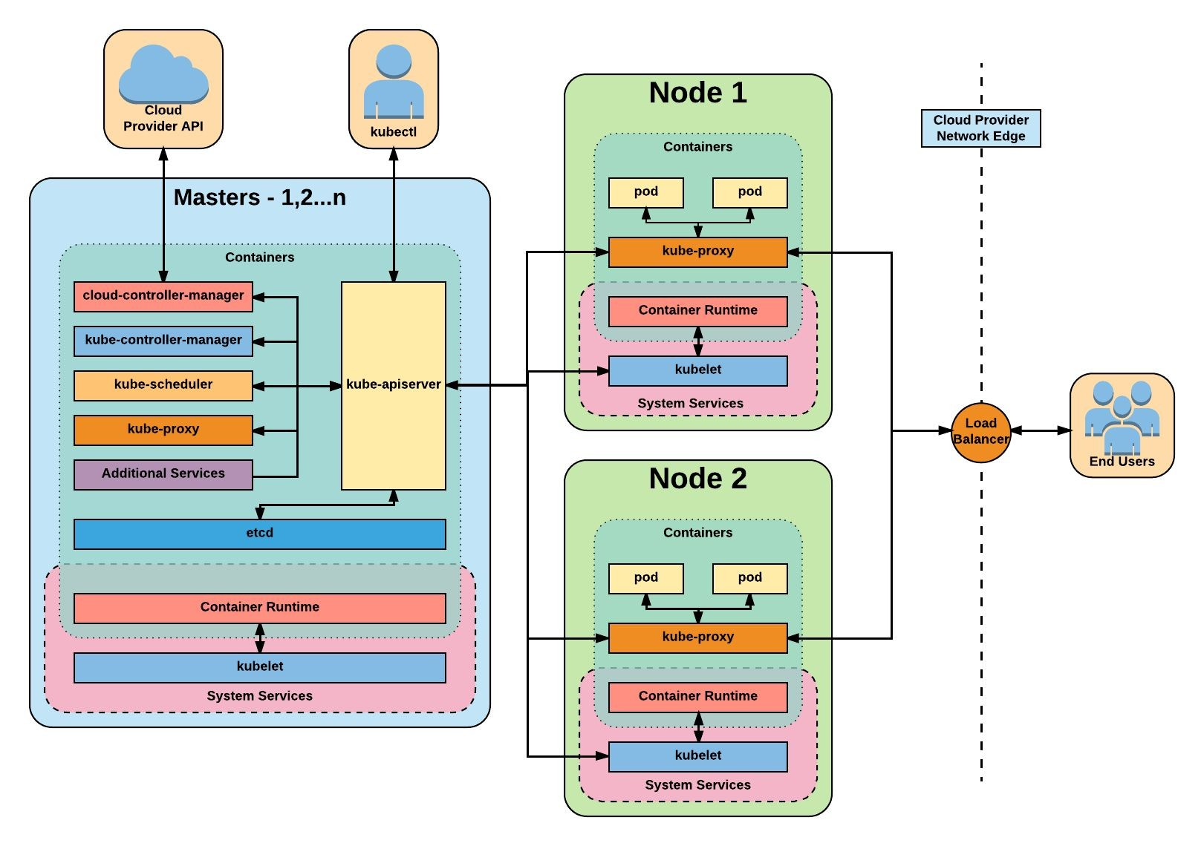
Architecture Overview

Slide 9
Master
Components

Slide 10
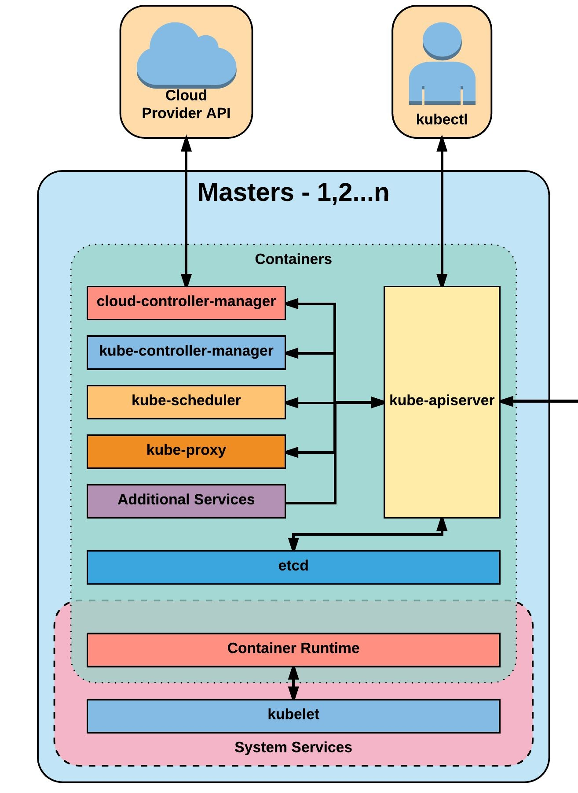
Master Components
Kube-apiserver
Etcd
Kube-controller-manager
Cloud-controller-manager
Kube-scheduler

Slide 11
kube-apiserver
The apiserver provides a forward facing REST interface into the kubernetes control plane and datastore. All clients, including nodes, users and other applications interact with kubernetes strictly through the API Server.
It is the true core of Kubernetes acting as the gatekeeper to the cluster by handling authentication and authorization, request validation, mutation, and admission control in addition to being the front-end to the backing datastore.

Slide 12
etcd
Etcd acts as the cluster datastore; providing a strong, consistent and highly available key-value store used for persisting cluster state.

Slide 13
kube-controller-manager
The controller-manager is the primary daemon that manages all core component control loops. It monitors the cluster state via the apiserver and steers the cluster towards the desired state.

Slide 14
cloud-controller-manager
The cloud-controller-manager is a daemon that provides cloud-provider specific knowledge and integration capability into the core control loop of Kubernetes. The controllers include Node, Route, Service, and add an additional controller to handle PersistentVolumeLabels .

Slide 15
kube-scheduler
Kube-scheduler is a verbose policy-rich engine that evaluates workload requirements and attempts to place it on a matching resource. These requirements can include such things as general hardware reqs, affinity, anti-affinity, and other custom resource requirements.

Slide 16
Node
Components

Slide 17
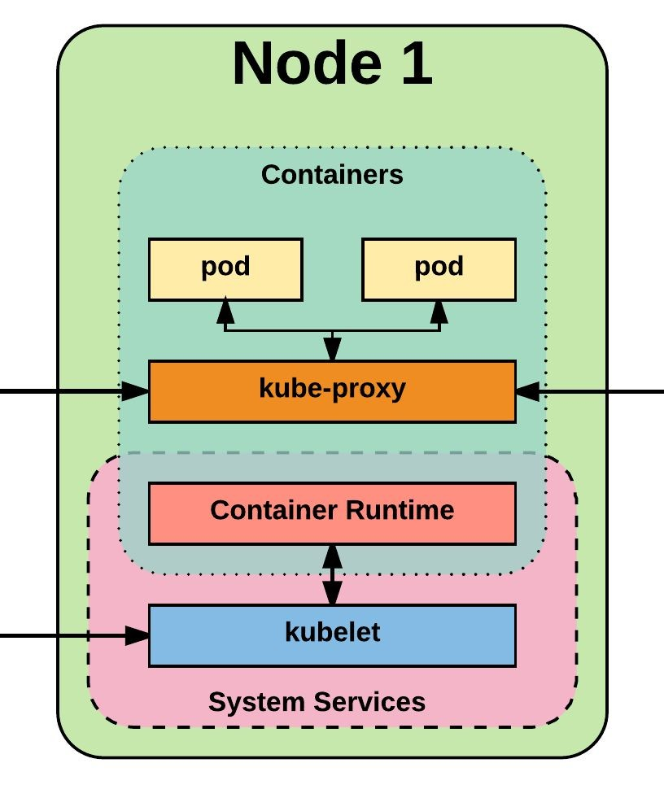
Node Components
Kubelet
Kube-proxy
Container runtime engine

Slide 18
kubelet
Acts as the node agent responsible for managing pod lifecycle on its host. Kubelet understands YAML container manifests that it can read from several sources:
File path
HTTP Endpoint
Etcd watch acting on any changes
HTTP Server mode accepting container manifests over a simple API.

Slide 19
kube-proxy
Manages the network rules on each node and performs connection forwarding or load balancing for Kubernetes cluster services.
Available Proxy Modes:
Userspace
iptables
ipvs (alpha in 1.8)

Slide 20
Container Runtime
With respect to Kubernetes, A container runtime is a CRI (Container Runtime Interface) compatible application that executes and manages containers.
Containerd (docker)
Cri-o
Rkt
Kata (formerly clear and hyper)
Virtlet (VM CRI compatible runtime)

Slide 21
Additional Services
Kube-dns - Provides cluster wide DNS Services. Services are resolvable to
<service>.<namespace>.svc.cluster.local.
Heapster - Metrics Collector for kubernetes cluster, used by some resources such as the Horizontal Pod Autoscaler. (required for kubedashboard metrics)
Kube-dashboard - A general purpose web based UI for kubernetes.

Slide 22
Kind Cluster (Kubernetes In Docker)
Tool to run local Kubernetes Clusters using Docker containers.
Creating a Cluster:
kind create cluster --image ‹image name> --name cka-cluster kubectl cluster-info---context kind-cka-clusterl kubectl get nodes

Slide 23
Minikube Overview
• A lightweight Kubernetes tool that allows you to run a single-node Kubernetes cluster on your local machine.
• Ideal for learning, development, and testing Kubernetes configurations locally.
Key Features:
• Supports multiple hypervisors (VirtualBox, Docker, Hyper-V, etc.).
• Provides an easy way to explore Kubernetes components like Pods, Services, and Deployments.
• Compatible with kubectl for managing the cluster.

Slide 24
Setting up Minikube Locally
Prerequisites:
- Install a hypervisor (e.g., VirtualBox, Docker), Install kubectl and Minikube.
Step 1: Start Minikube
- minikube start --driver=<driver-name>
Step 2: Verify Minikube Cluster
- minikube status
Step 3: Get Cluster Info
- kubectl cluster-info
Step 4: Check Nodes
- kubectl get nodes
Step 5: Access Minikube Dashboard
minikube dashboard
Additional Commands:
• Stop the cluster:
minikube stop
• Delete the cluster:
minikube delete
Step 5: Access Minikube Dashboard
- minikube dashboard
Additional Commands:
Stop the cluster:
- minikube stop
Delete the cluster:
- minikube delete

Slide 25
Multi-Node Cluster Example
Config File (config. yaml) :
kind: Cluster
apiVersion: kind.x-k8s.io/vlalpha4
nodes:
• role : control-plane
• role : worker
• role : worker
Create cluster :
kind create cluster --image (image_name> --name cka-cluster2 --config config. yaml
kubectl config --set-context kind-cka-clusterl

Slide 26
Pods
Imperative Creation:
kubectl run nginx-pod --image=nginx:latest
Declarative Creation:
Create pod.yaml:
apiVersion: v1
kind: Pod
metadata:
name: nginx-pod
labels:
env: demo
type: frontend
spec:
containers:
- name: nginx-container
image: nginx
ports:
- containerPort: 80
kubectl create -f pod.yaml

Slide 27
Static Pods
Static Pods are managed directly by the kubelet daemon on a specific node, bypassing the Kubernetes API server.
Useful for critical system components or specific configurations tied to a node.
Example Configuration:
apiVersion: v1
kind: Pod
metadata:
name: static-nginx-pod
spec:
containers:
- name: nginx-container
image: nginx
ports:
- containerPort: 80

Slide 28
Labels
Labels are key-value pairs attached to Kubernetes objects, used for organization, categorization, and selection
Example:
apiVersion: v1
kind: Pod
metadata:
name: labeled-pod
labels:
app: myapp
tier: frontend
spec:
containers:
- name: myapp-container
image: myapp:latest
Select Pods with a Label:
- kubectl get pods -l app=myapp

Slide 29
Taints and Tolerations
Taints ensure pods are not scheduled onto inappropriate nodes.
Tolerations allow pods to be scheduled on nodes with specific taints.
Apply Taint to a Node:
kubectl taint nodes <node-name> key=value:NoSchedule
Add Toleration to a Pod:
apiVersion: v1
kind: Pod
metadata:
name: tolerant-pod
spec:
tolerations:
- key: "key"
operator: "Equal"
value: "value"
effect: "NoSchedule"
containers:
- name: myapp-container
image: myapp:latest

Slide 30
Behind
The Scenes

Slide 31
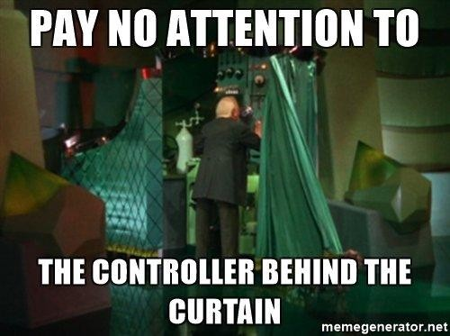
Behind
The Scenes

Slide 32
Deployment From
Beginning to End

Slide 33
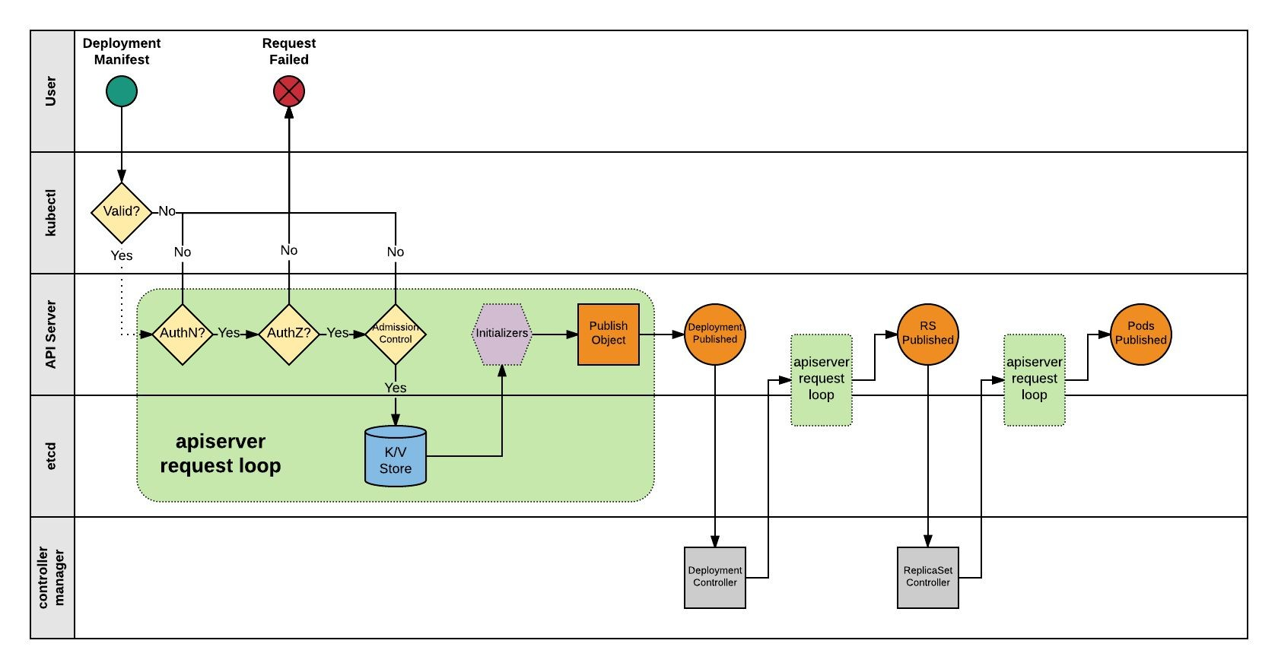

Slide 34
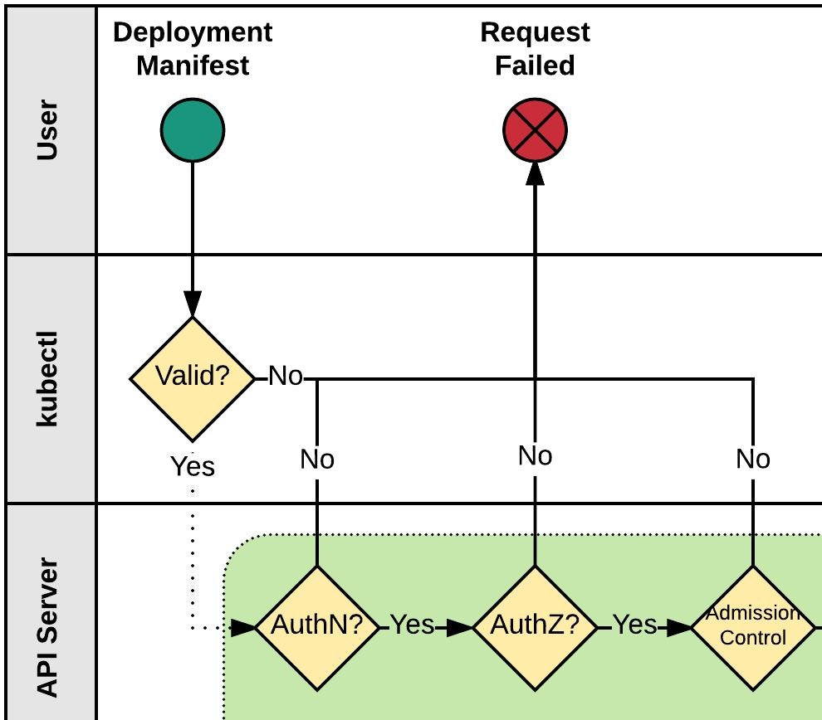
Kubectl
Kubectl performs client side validation on manifest (linting).
Manifest is prepared and serialized creating a JSON payload.

Slide 35
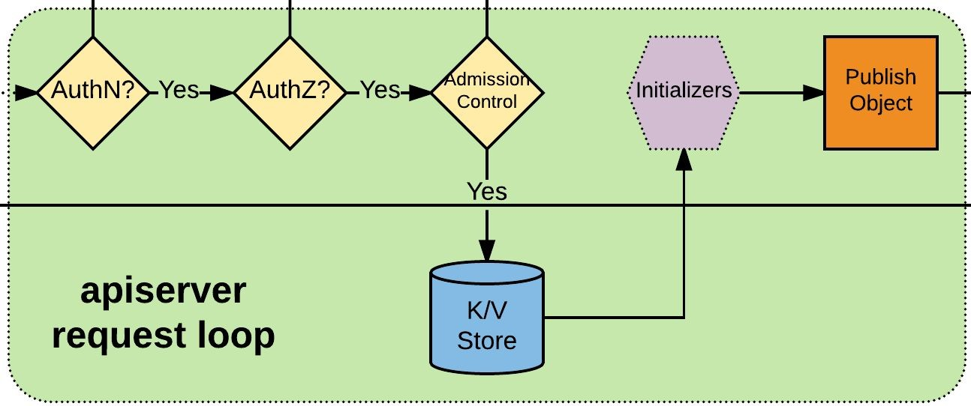
APIserver Request Loop
Kubectl authenticates to apiserver via x509, jwt, http auth proxy, other plugins, or http-basic auth.
Authorization iterates over available AuthZ sources: Node, ABAC, RBAC, or webhook.
AdmissionControl checks resource quotas, other security related checks etc.
Request is stored in etcd.
Initializers are given opportunity to mutate request before the object is published.
Request is published on apiserver.

Slide 36
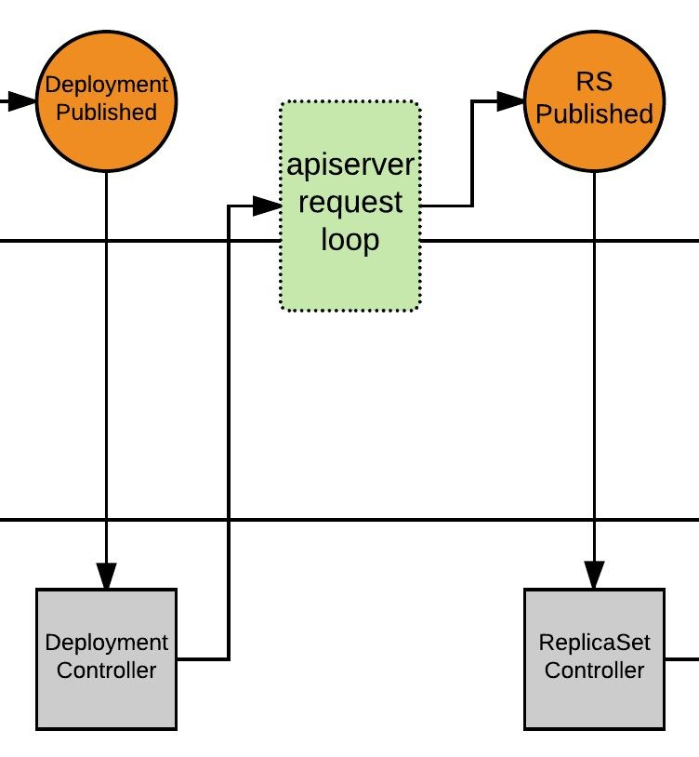
Deployment Controller
Deployment Controller is notified of the new Deployment via callback.
Deployment Controller evaluates cluster state and reconciles the desired vs current state and forms a request for the new ReplicaSet.
apiserver request loop evaluates Deployment Controller request.
ReplicaSet is published.

Slide 37
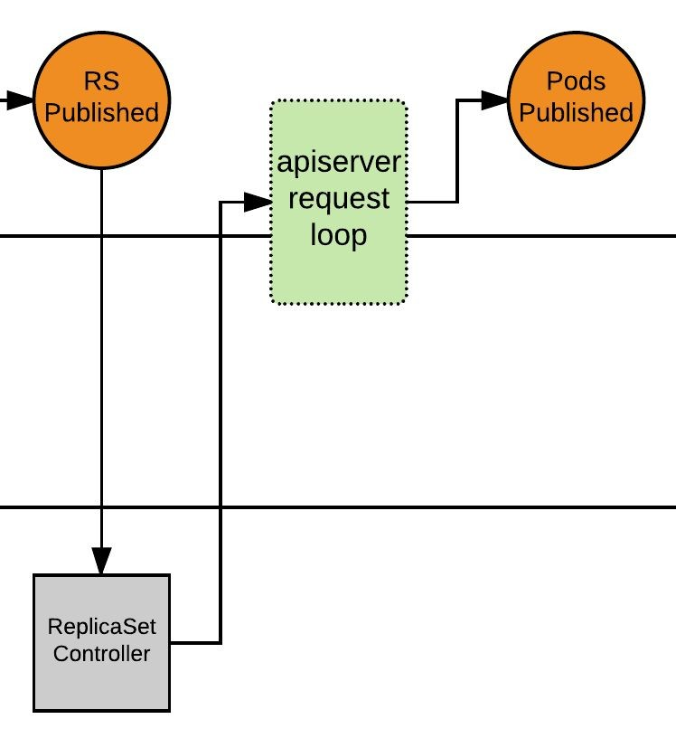
ReplicaSet Controller
ReplicaSet Controller is notified of the new ReplicaSet via callback.
ReplicaSet Controller evaluates cluster state and reconciles the desired vs current state and forms a request for the desired amount of pods.
apiserver request loop evaluates ReplicaSet Controller request.
Pods published, and enter ‘Pending’ phase.

Slide 38
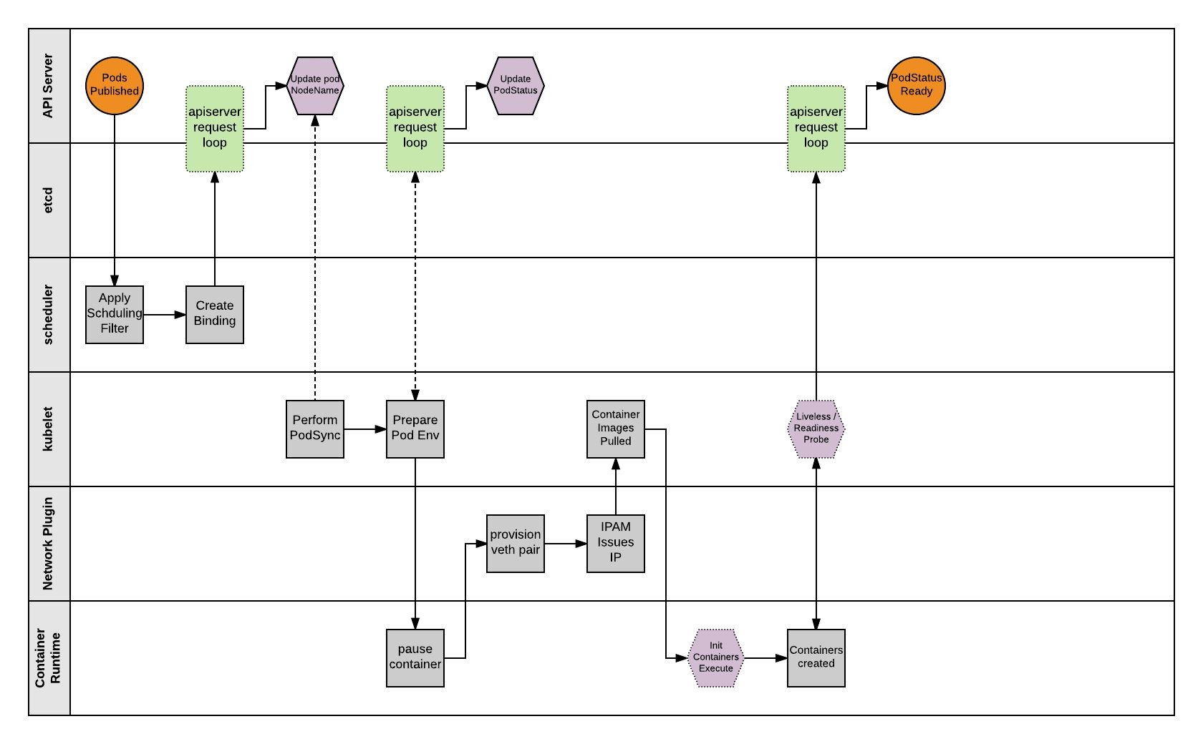

Slide 39
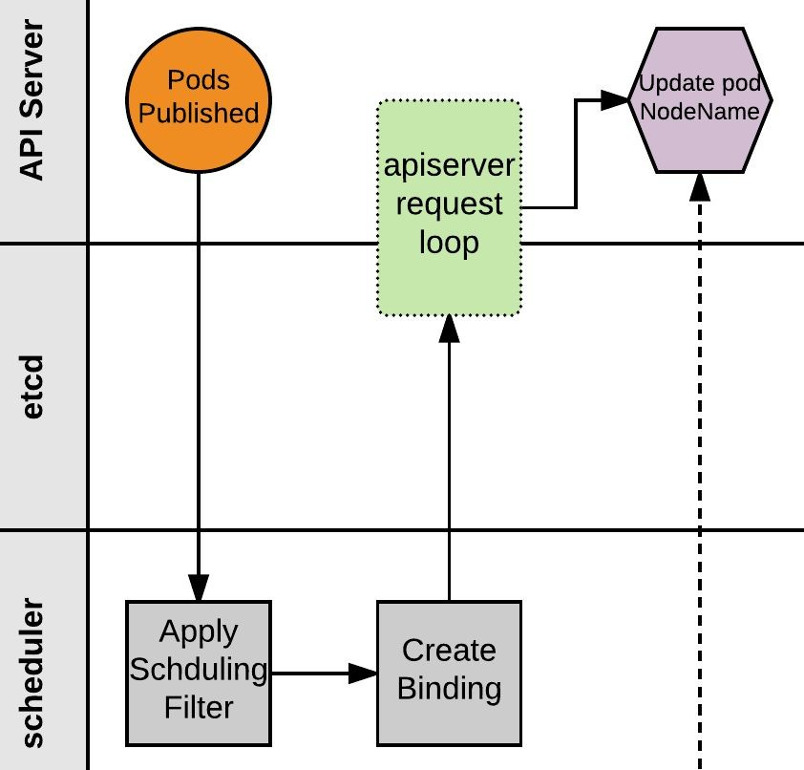
Scheduler
Scheduler monitors published pods with no ‘NodeName’ assigned.
Applies scheduling rules and filters to find a suitable node to host the Pod.
Scheduler creates a binding of Pod to Node and POSTs to apiserver.
apiserver request loop evaluates POST request.
Pod status is updated with node binding and sets status to ‘PodScheduled’.

Slide 40
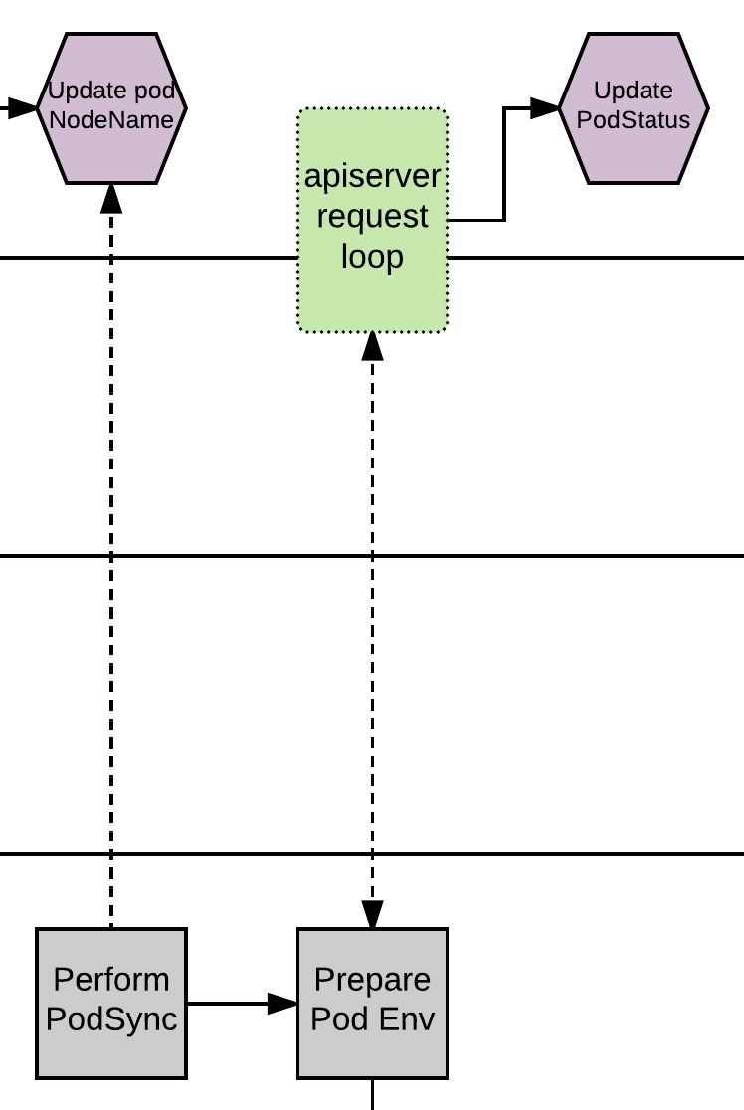
Kubelet - PodSync
The kubelet daemon on every node polls the apiserver filtering for pods matching its own ‘NodeName’; checking its current state with the desired state published through the apiserver.
Kubelet will then move through a series of internal processes to prepare the pod environment. This includes pulling secrets, provisioning storage, applying AppArmor profiles and other various scaffolding. During this period, it will asynchronously be POST’ing the ‘PodStatus’ to the apiserver through the standard apiserver request loop.

Slide 41
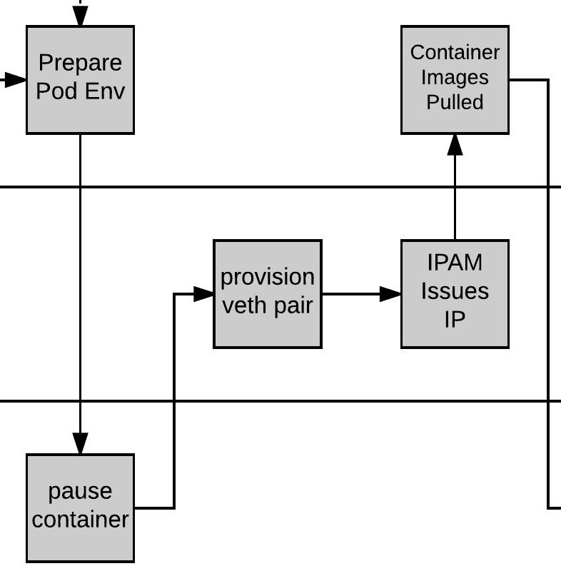
Pause and Plumbing
Kubelet then provisions a ‘pause’ container via the CRI (Container Runtime Interface). The pause container acts as the parent container for the Pod.
The network is plumbed to the Pod via the CNI (Container Network Interface), creating a veth pair attached to the pause container and to a container bridge (cbr0).
IPAM handled by the CNI plugin assigns an IP to the pause container.

Slide 42
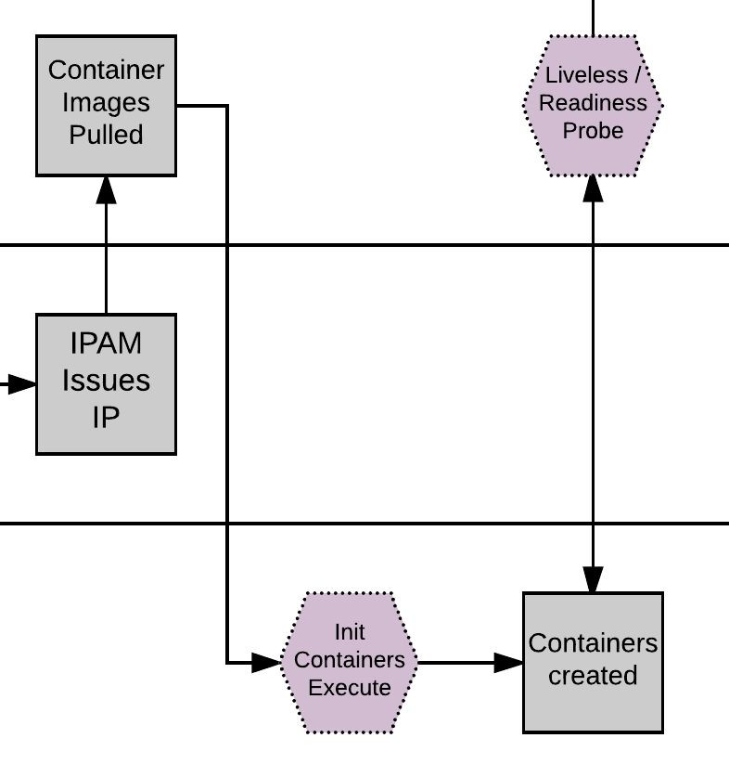
Kublet - Create Containers
Kubelet pulls the container Images.
Kubelet first creates and starts any init containers.
Once the optional init containers complete, the primary pod containers are started.

Slide 43
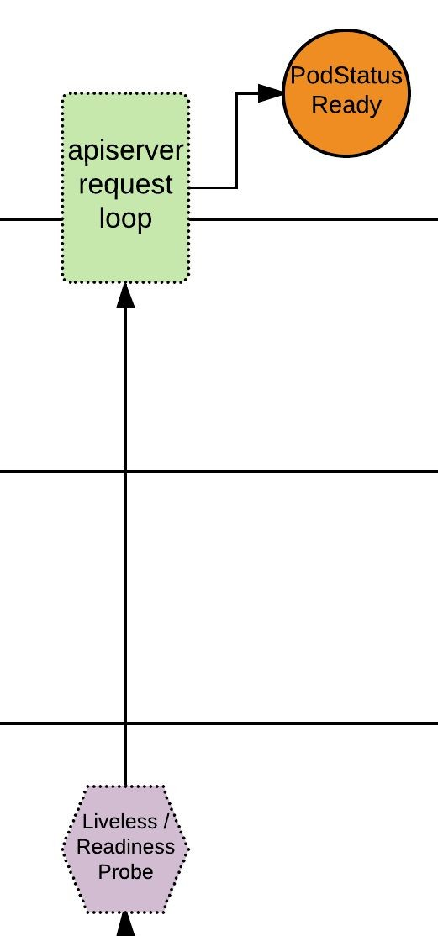
Pod Status
If there are any liveless/readiness probes, these are executed before the PodStatus is updated.
If all complete successfully, PodStatus is set to ready and the container has started successfully.
The Pod is Deployed!

Slide 44
CONCLUSION
Kubernetes is a powerful container orchestration tool.
Understanding its architecture and components is crucial.
Kind clusters, pods, static pods, labels, and taints & tolerations are key concepts.

Slide 45
THANK YOU

